Slide 1
Shall we replace the gas boilers with heat pumps?
A socio scientific issue
(The presentation includes two lessons of 40 minutes)

Slide 2
Lesson Layout
Lesson 1
5E phase | Work form | Group division | Lesson material | Estimated time
Engagement | Instruction | Whole Class | ppt, video | 5 minutes
Engagement | Interaction | Whole class | ppt, white Board | 10 minutes
Exploration | Group work | 3-4 students | ppt, worksheet | 10 minutes
Exploration & Evaluation | Interaction | Whole class | ppt, worksheet | 5 minutes
Explanation | Instruction | Whole class | ppt | 10 minutes

Slide 3
Lesson 2
5E Phase | Work Form | Group Division | Lesson Material | Estimated time
Explanation | instruction | Whole class | ppt | 15minutes
Elaboration | group work | 3-4 people | ppt, work sheet | 15 minutes
Elaboration & Evaluation | Interaction | whole class | ppt, work sheet | 5 minutes
Evaluation | Interaction | whole class | ppt | 5 minutes

Slide 4


Engagement

Slide 5
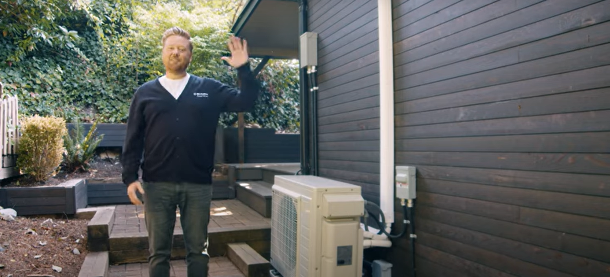
Video on heat pump and advantages of using it
Engagement
Add 2 minutes video
https://youtu.be/iQaycSD5GWE?si=PMjmXuW7zT0w3V9c

Slide 6
Prior knowledge
Engagement
Heat
Thermal Effects
Law of Conservation of Energy

Slide 7
Replacing Gas boilers with Heat pumps
Group Discussion:
Engagement
[The questions stated below will be asked to get the general discussion started in the classroom.]
What does energy use have to do with the climate?
What are the popular methods used for heating?
What is gas boiler?
What is a heat pump?
Do you ever use a gas boiler or heat pump at home?
What are the advantages of about Heat pump? What are the disadvantages of heat pump?

Slide 8
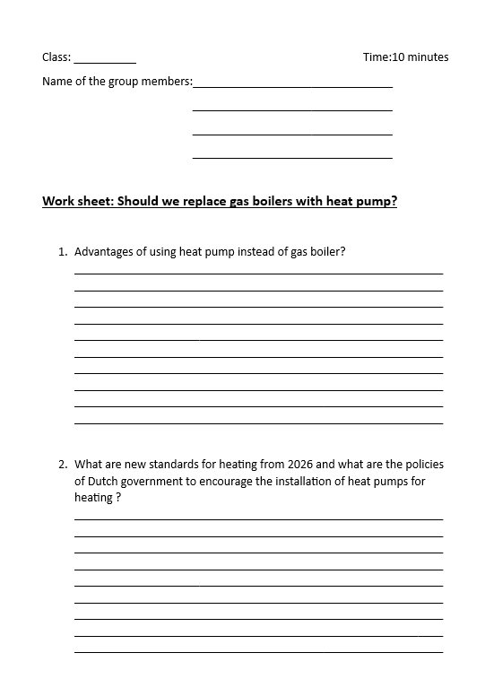
Replacing Gas boilers with Heat pumps
Exploration

Slide 9

Replacing Gas Boilers with Heat Pumps
Exploration
&
Evaluation
Group discussion:
Discuss answers and ask questions:
  Are your sources reliable?
  Who doesn't benefit from replacing gas boilers with heat pump?
  What are the new standards for heating from 2026?
  What are the Dutch government policies to encourage the
  installation of heat pump?

Slide 10
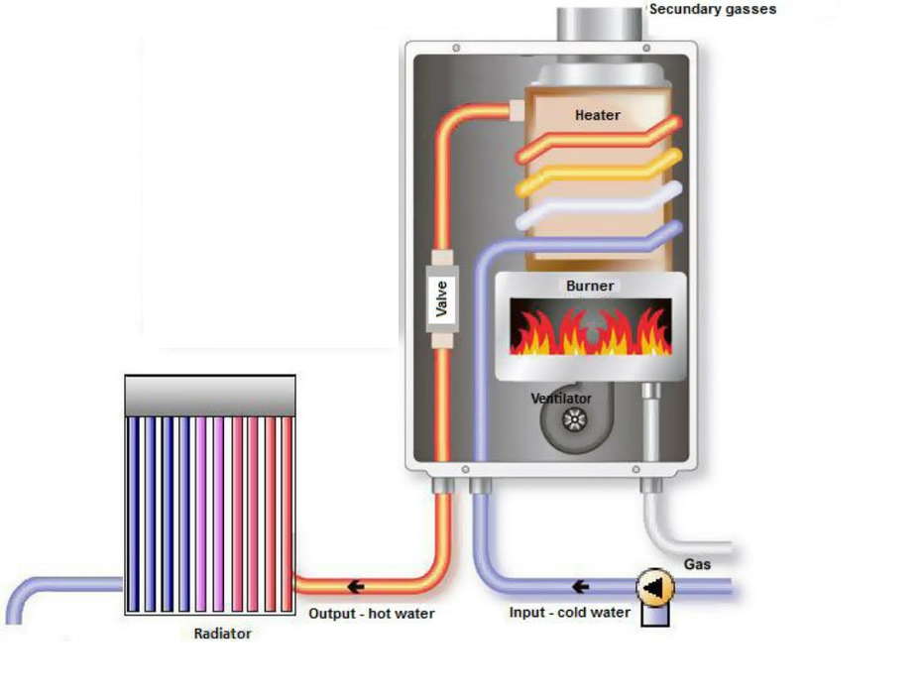
Gas Boiler
Explanation

Slide 11
Explanation

Slide 12
End of lesson 1 = start of lesson 2
Explanation
Review of last lesson:
And how can you compare two electrical appliances?
What is the difference between and efficiency and cop?
How can you calculate how much energy a device consumes?

Slide 13
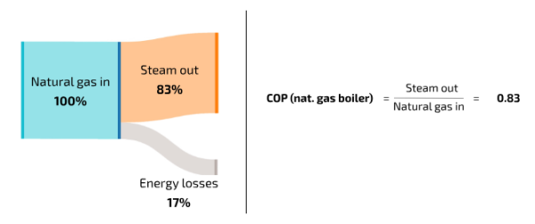

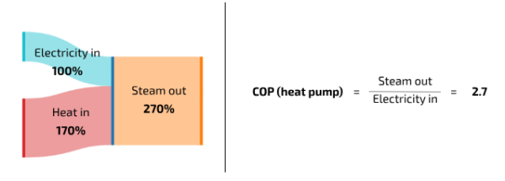
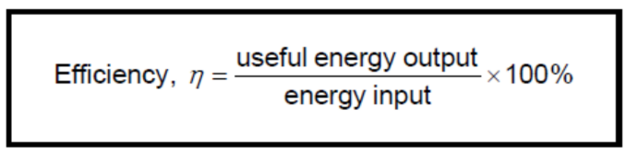
Comparison of Gas boiler and Heat pump
Explanation

Slide 14
Energy Consumption – a comparison
Explanation
150 sq meter house requires 72630 BTU for maintaining desired temperature for 1 hour, compare the energy required by HR Boiler and a heat pump. 1 kWh = 3412 BTUs
Commercial HR Boiler (gas) REMEHa Quinta ACE Efficiency: 98% | Commercial Heat Pump NIBE F2040 COP: up to 4.7
Energy Consumption in kWh = BTUs required / (efficiency * BTUs per kWh) = 72630 / (0.98 * 3412) = 21.71 kWh | Energy consumption in kWh = BTUs required / (COP * BTUs per kWh) = 72630 / (4.7 * 3412) = 4.54 kWh

Slide 15
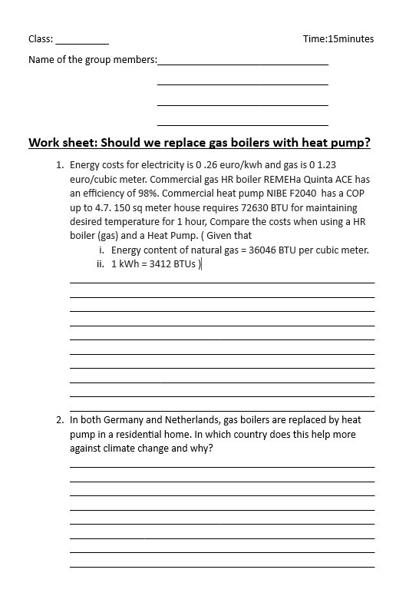

Replacing Gas Boiler with Heat Pumps
Elaboration

Slide 16
Replacing Gas Boilers with Heat Pumps
Elaboration & Evaluation
Group discussion:
about the questions( with extra attention to the question:
Should we replace gas boilers with heat pumps?)

Slide 17
Replacing Gas boilers with Heat pumps
Short lesson evaluation (closed-ended questions)
Evaluation
Short lesson evaluation (closed-ended questions);
Did you learn anything?
Was it difficult?
Was it more fun than a regular theory lesson?
Have you put in more effort than usual?
Would you like to have a lesson like this more often?
Homework question:
• Can you explain to your parents why should we replace the gas boiler with heat pump?

Slide 18
Comments by Mentor
Mentor found the topic to be relevant and interesting.
She was concerned about the student’s behavior in the classroom.
All the students may not participate in the lesson.
It might take more time than estimated.

Slide 19

Thank you !

